Slide 1
AAU-CHS Department of surgery Pre OP preparation &post OP complication
Dr. Inku.c GSR 3

Slide 2
OUTLINE
Objectives
Systematically approached evaluation
Additional consideration
potential causes of intraoperative instability
Pre operative check list

Slide 3
Introduction
A chance to cut should be a chance to cure
Surgery = stress and insults Surgery = stress and insults
Outcome of surgery depends on s
The pathological condition of the patient–
Preoperative condition and performance status of patient
Intraoperative details including surgical technique and procedure done–
Post operative care
Preoperative evaluation: H&P
Generally referred to us Perioperative care:

Slide 4
Preoperative Evaluation
Should be comprehensive in order to
Determine operative risk
Guide preoperative preparation
Assess the patients general health
Influence future well-being of patient

Slide 5
1 Gathering and recording concisely all relevant information.
2 Planning to minimise risk and maximise benefit for the patient.
3 Being prepared for adverse events and how to deal with them.
4 Communicating with the patient and all other members of the team.

Slide 6
Routine preoperative preparation
Appropriate diagnosis
Decision on the type of procedure
Procedure should give better quality of life for the patient
Patient understanding of the intended procedure with prons and cons with consent
Optimization of the patient for the planned surgery
Preparation for the gadgets required for the successful surgery as planned including the needed professionals

Slide 7
Then the preoperative evaluation
History & examination.
Assessment of risks for surgery and anesthesia
Preoperative tests.
Nutritional assessment
Prophylaxis
Rational use of antibiotics.
DVT & Pulmonary emboli risk
Evaluation of anesthetic risks and difficulties
Control of chronic illnesses and medication
Check list performed preoperatively.

Slide 8
Problem Identification
Cardiovascular : hypertension ; ischemia , valvular or congenital heart disease; CHF or cardiomyopathy, , arrhythmias
Respiratory : smoking; COPD; restrictive lung disease; altered control of breathing (obstructive sleep apnea, CNS disorders, etc.)
Neuromuscular : raised ICP ; TIA's or CVA's; seizures; spinal cord Injury; disorders of NM junction e.g myasthenia gravis, muscular dystrophies ,MH
Endocrlne : DM; thyroid disease; pheochromocytoma; steroid therapy
GI - Hepatic : hepatic disease; gastresophageal reflux, PHPN
Renal : renal failure
Hematologic : anemias; coagulopathies
Elderly , Children, Pregnancy
Medications and Allergies
Prior Anesthetics
Related to Surgery : significant blood loss; respiratory compromise; positioning

Slide 9
History & examination
A full history - including presenting complaints & relevant history
Past medical history
Drug history
Immunization history
Complete clinical examination
General Examination
Relevant systemic examination
Any systemic examination related to past medical illness

Slide 10
Preoperative Laboratory Testing
Young and fit patients with no comorbidity undergoing minor surgery - usually not investigation.
For major surgery, elderly patient or patient with significant medical problems, routine investigations are required. E.g.
Complete blood count;
Urine analysis
Chest X ray P/A view
Random blood sugar
Serum Creatinine
Basic liver enzymes and function tests
ECG
Blood grouping and cross matching.
Besides this, due to high prevalence
HBsAg & HIV screening should be encouraged

Slide 11
Prophylaxis against DVT & Pulmonary emboli
The risk factors can be minimized preoperatively by: CAPRINI SCORE
Stratification of patients with risk factors
Pre and post operative subcutaneous heparin administration.
Graduated compression stockings.
Intraoperative intermittent pneumatic calf compression.

Slide 12
Thromboembolism
Risk factors
Age > 60 years
Immobilization
Trauma
Heart failure
Obesity
Pregnancy/puerperium
Family/personal history of thrombosis
OCP, smoking
Notes:
Low risk Moderate High; type of surgery; Mechanical-(early mobilization, neuraxial anaesthesia, leg compression stockings, calf and foot pumps, minimize use of tourniquets) pharma-heparin, warfarin, asprin, direct thrombin inhibitors, pentasaccharides)

Slide 13
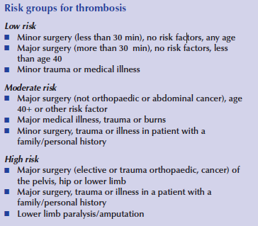

Slide 14
Prophylaxis against thrombosis
Moderate-high risk groups
Individualization (for specific patient and surgery)
Mechanical
Pharmacological >> variable risk of bleeding

Slide 15
Assessment of Anesthesia risk for Surgery
Internationally there are multiple prognostic scoring systems which are widely used regarding assessment of risk of surgery:
APACHE (Acute Physiology And Chronic Health Evaluation) system
ASA (American Society of Anesthesiologist) system.
ECOG / KORNOVESKY

Slide 16



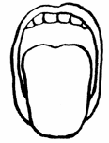
Mallampati
Class I = visualize the soft palate, fauces, uvula, anterior
and posterior pillars.
Class II = visualize the soft palate, fauces and uvula.
Class III = visualize the soft palate and the base
of the uvula.
Class IV = soft palate is not visible at all.

Slide 17
Assessment of risk of Surgery
APACHE System
Acute Physiology Score (APS)
1. Rectal temperature (⁰C) | 7. Serum Sodium (mmol/L)
2. Mean blood pressure | 8. Serum Potassium (mmol/L)
3. Heart rate | 9. Serum creatinine
4. Respiratory rate | 10. Haematocrit
5. Alveolar arterial O₂ gradient. | 11. Total WBC
6. Arterial _{p}H | 12. GCS level
B. Age points graded from <44 to >75 years
C. Chronic health points

Slide 18
ASA Physical Status Classification System
 | medical status | mortality
ASA I | normal healthy patient without organic, biochemical, or psychiatric disease | 0.06-0.08%
ASA II | mild systemic disease with no significant impact on daily activity e.g. mild diabetes, controlled hypertension, obesity . | Unlikely to have an impact 0.27-0.4%
ASA III | severe systemic disease that limits activity e.g. angina, COPD, prior myocardial infarction | Probable impact 1.8-4.3%
ASA IV | an incapacitating disease that is a constant threat to life e.g. CHF, unstable angina, renal failure ,acute MI, respiratory failure requiring mechanical ventilation | Major impact 7.8-23%
ASA V | moribund patient not expected to survive 24 hours e.g. ruptured aneurysm | 9.4-51%
ASA VI | brain-dead patient whose organs are being harvested

Slide 19
Preoperative preparation
CHRONIC ILLNESSES
DM
HPT
ASTHMA
COAGULASBILITY
CARDIAC ILLNESS
CHRONIC LIVER / RENAL DISEASE …
PREPARATION FOR THE SURGERY
BOWEL PREPARATIN
LAVAGE
PROPHYLAXIS ANTICOAGULANT
TUBES INSERTION
PROPHYLAXIS ANTIBIOTIC …

Slide 20
Management for a Diabetic Pt
Diabetic pt are in a high risk for any surgery due to
Increase susceptibility to infection,
Delayed wound healing, v
Vascular complications (eg. DVT,IHD,CVD)
ASSESSMENT OF END ORGAN DAMAGE !!!!
Minor surgery - stop the oral dose in the operative morning & replaced by short acting insulin
Major surgery-oral dose should be omitted 1-2 days prior to surgery & replaced by short acting insulin

Slide 21
Management for a Diabetic Pt
Hemoglbin A1C gives a good assessment of the control for diabetes in the past 3 months
Oral hypoglycemic agents can be re-Instituted as soon as the pt is on oral diet
Hypoglycemia must be avoided & if required consultation from an endocrinologist should be sought
Modified or standard sliding scales can be used for preoperative control of diabetes in major surgery

Slide 22
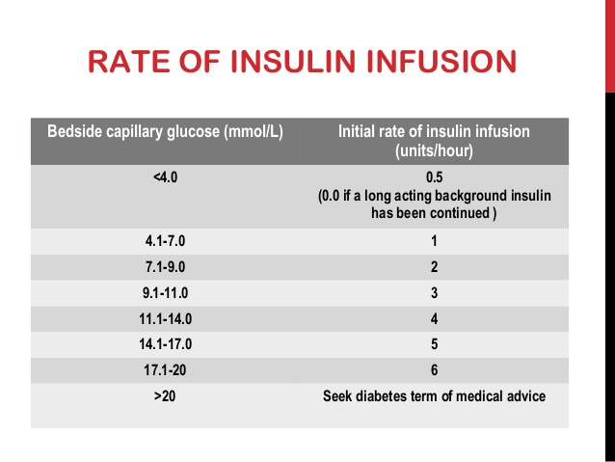
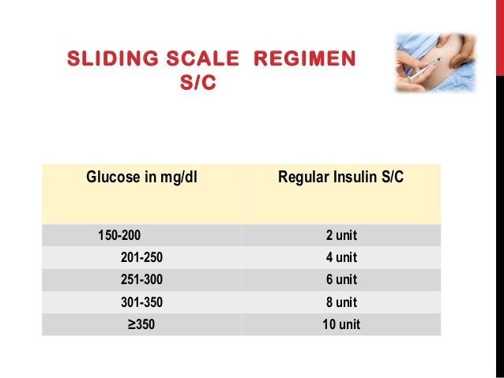
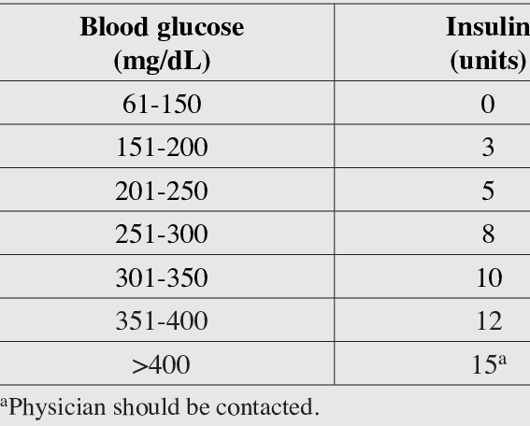

Slide 23


Slide 24
Management of hypertension
Assessment of the end organ damages of the disease is of paramount importance
Then the degree of control of hypertension is very important
Chronically uncontrolled HPN will result in marked swings in BP intra-operatively and postoperatively
For patients with unacceptable BP on follow up needs to have control before surgery if surgery can be postponed
Common complication are
MI
Left ventricular Failure
stroke and cerebral hemorrhage
hypertensive encephalopathy and
Renal failure

Slide 25
Diastolic pressure measured pre operatively less than 110 has no significant POC
In emergency conditions
If hypertension is newly diagnosed or uncontrolled –
Decision depends on whether the surgery can be postponed for few days or not if not
Emergency Bp lowering agents can be used with relatively low increased risk of CV complications
Definition of hypotension in such patents should be carefully seen as a low normal BP can be severe hypotension for them

Slide 26
Assessment of Cardiovascular risk
Risk factors are:
Recent MI,
Clinical heart failure,
Systemic HTN,
History of arrythmia.
The risks are highest in the 1st 3 months following infarct.
Gradually decreases in the next 6 months
Elective surgery can be considered 6 months later
Always consult with a cardiologist regarding these patients before surgery.
ECG should be performed as a routine investigation for this group,Echo on indication

Slide 27
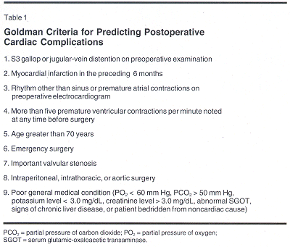
Points given are 11-10-7-7-5-5-3-3-3 from 1 to 9 in order
Any patient with a total score of 13 or more is considered as a high risk patient with 11% rate of life threatening complication
if the score is above 26 mortality from anesthesia and surgery is more than 50%

Slide 28
Assessment for Respiratory risk
The most common respiratory condition to encounter preoperatively are COPD & Asthma.
Certain parameters should be measured in these patients:
- Vital Capacity
- FEV1
- ABG
Epidural analgesia is the best one for this group both pre, intra & post operative analgesia.
Incentive spirometry
Guidance should be given preoperatively on breathing exercise.
Antibiotic should be given preoperatively to prevent postoperative chest infection
Smoking secession at least for 8 weeks before surgery

Slide 29
Assessment of renal risk
CKD is the most common renal risk that is encountered preoperatively in this group
Blood Urea & S. Creatinine should be done
Moderate elevation of urea & Creatinine can be considered in elderly patient
Patient on dialysis should be dialyzed preoperatively to ensure good fluid balance & to correct any hyperkalemia
Patient on renal transplants require to have their immunosuppressant preoperatively
Ensure adequate hydration to avoid precipitating renal failure in frail & critically ill patient.
Always consult with a nephrologist

Slide 30
Nutritional Assessment
Malnutrition is a well established cause of morbidity & mortality in surgery
Nutritional assessment can be based on:
Total body weight loss.
Anthropomorphic measurement e.g. skin fold thickness, mid arm circumference etc.
Biochemical test e.g. Serum total protein, S. albumin, S. transferrin etc.
Nutritional support should be started at an early stage by high calorie diet or insertion of a feeding enterostomy or central venous feeding line

Slide 31
Management of obesity
One of the major cause of mortality (about 40%) in surgery from IHD & DVT
Fat free diet should be considered before surgery
Prophylaxis against DVT should be done
Counseling regarding possible postoperative complication must be done

Slide 32
Assessment of anemia & Blood disorder condition
Patient having Hb% <10g/dl
should be transfused.
In very emergency surgery,
Hb% upto 8 g/dl can be considered providing
intraoperative blood transfusion available.
Any blood disorder should be consulted with a hematologist.

Slide 33
Assessment of anaemia & Blood disorder condition
Pt having warfarin should be stopped 48 hrs preoperatively & replaced by heparin.
Antiplatelet agents should be stopped 5-7 days prior to surgery.
Pt having INR 1.5 or more should be treated with Vit. K. and / FFP

Slide 34
Prepare for Surgery in Special Groups
Bowel surgery:
Bowel preparation is considered prior to bowel surgery.
For elective surgery, bowel preparation is most commonly achieved by
placing the pt on liquid diet 3 days
administering oral purgatives or enema on the day prior to surgery + ANTIBIOTICS
Specially for small bowel surgery, proper hydration & nutrition should be maintained.
If there is evidence of obstruction, an NG tube should be inserted to prevent aspiration.

Slide 35
Prepare for Surgery in Special Groups
Preparation for Jaundiced patient:
The risk of surgery in a pt with obstructive jaundice can be reduced significantly by careful preoperative management.
Preoperative drainage by a Biliary endo-prosthesis should be considered in elderly pts who are deeply jaundiced or all pt with biliary tract sepsis.
Vit K should be given to all pt with obstructive jaundice prior to surgery at least for 4 days
A coagulation profile should be checked.
Adequate hydration should be done to prevent hepato-renal syndrome.
Antibiotic prophylaxis should be given to combat high infective complications in a jaundiced pt

Slide 36
Prepare for Surgery in Special Groups
Endocrine Surgery:
Thyrotoxicosis pts, a period of antithyroid drug & beta blockers is given to prevent thyrotoxic crisis.
Pheocromocytoma may require admission a week before surgery to evaluate & block the alpha & beta adrenergic effects of catecholamines.

Slide 37
Prepare for Surgery in Special Groups
Thoracic Surgery:
- Assessment of respiratory function is the most important aspect of preoperative preparation.
- Active preoperative chest physiotherapy,
- Treatment of any respiratory infections with antibiotics and good post operative analgesia minimize the risk of postoperative respiratory failure.
- Subcutaneous heparin is routine to prevent pulmonary embolus.

Slide 38
Surgical Emergency
AMPLE history -
A - Allergies
M - Medications
P - Past medical history
L - Last meal
E - Events preceding the surgery

Slide 39
Basic Check list for preoperative order
Fitness from pre anesthetic check up.
Informed written consent from the patient/ patient party.
Cleanliness and proper shaving of the operative area (if required) - Hair clipped, not shaved.
Antibiotic 30-60 minutes prior to surgery, DC 24 hrs after operation
Pre-op Note & Pre-op Orders
Urinary catheter removed within 24 hrs of surgery
prophylaxis VTE
Give beta-blockers if currently on this med
Arrange for blood transfusion (if required).
Anxiolytics in the previous night of operation.
Hydration by I/V fluid (preferably crystalloid).
Any specific preparation for a particular surgery.
Adjustment of medication related to co morbid conditions.

Slide 40
Operative Permit
Must be signed by the patient or legal guardian
The nature, risk & probable result of the operation must be included

Slide 41
Informing the Patient
Explanation of the surgery
Risks & consequences
Explain what will happen in OR before anesthesia
In the recovery room
eg. speech may be hindered,
tube may be inserted

Slide 42
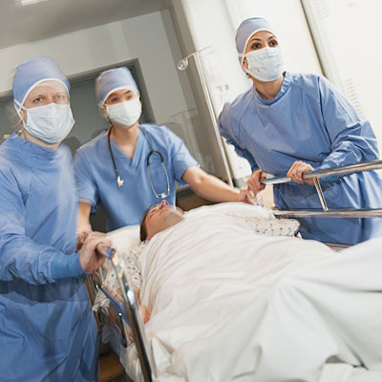
Preparation immediately before surgery
Confirm patient’s identity
Check for changes in condition
Consent
All investigation results available
Check for sepsis
Record neurovascular status
Mark side
Shave surgical area may also be done immediately before incision
Notes:
(ask if they want to repeat consent process);
sepsis (skin, teeth, urine, chest)

Slide 43
Bowel preparation
Methods used for bowel preparation
1. Prepare the bowel using:
.mechanical method(cleansing enema)
.pharmacological method (castor oil or polyglycol solution)
2. Keep on fluid diet for 3 days
3. antibiotics
4. NPO for 6hr prior to surgery
.Contraindication for bowel preparation
. Complete bowel obstruction
. Perforation

Slide 44
NPO regimen
Reduction of volume and acidity of the stomach contents during surgery
Oral medication can be given with water even when a patient is ‘nil by mouth’

Slide 45

Fasting Recommendations
INGESTED MATERIAL | MINIMUM FASTING PERIOD, APPLIED TO ALL AGES (hr)
Clear liquids | 2
Breast milk | 4
Infant formula | 6
Nonhuman milk | 6
Light meal (toast and clear liquids) | 6

Slide 46
There is no patient unfit for surgery rather the treating health professional / setup is unfit for the patient

Slide 47


Slide 48
Clean and aseptic surgical technique
By Dr Inku c-GSR3

Slide 49
Infection Control in Surgical Practice
Surgical procedures, by their very nature, interfere with the normal protective skin barrier
Expose the patient to microorganisms from both endogenous and exogenous sources
Traditional control measures include
Sterilization of surgical equipment,
Disinfection of the skin,
Use of prophylactic antibiotics
Expeditious operation

Slide 50
The Surgical Wound and Infection Control
Nosocomial infections are defined as infections acquired in the hospital.
There must be no evidence that the infection was present or incubating at the time of hospital admission.
Usually, an infection that manifests 48 to 72 hours after admission is considered to be nosocomial acquired

Slide 51
Identification of Risk Factors
The risk of development of an SSI depends on
Host factors
Perioperative wound hygiene
Duration of the surgical procedure.
Including length of the hospital stay
Appropriate management of the hospital environment

Slide 52
Operative Risk Factors
Several factors related to the operative procedure may be associated with the risk of development of an SSI .
These include:-
Method of hair removal (and likelihood of consequent skin injury),
Inappropriate use of antimicrobial prophylaxis
Duration of the operation
Wound classification.

Slide 53
Clean (class I) | Nontraumatic No inflammation encountered No break in technique Respiratory, alimentary, or genitourinary tract not entered
Clean-contaminated (class II) | Gastrointestinal or respiratory tract entered without significant spillage Appendectomy Oropharynx entered Vagina entered Genitourinary tract entered in absence of infected urine Biliary tract entered in absence of infected bile Minor break in technique
Contaminated (class III) | Major break in technique Gross spillage from gastrointestinal tract Traumatic wound, fresh Entrance of genitourinary or biliary tracts in presence of infected urine or bile
Dirty and infected (class IV | Acute bacterial inflammation encountered, without pus Transection of 'clean' tissue for the purpose of surgical access to a collection of pus Traumatic wound with retained devitalized tissue, foreign bodies, fecal contamination, or delayed treatment, or all of these; or from dirty source
1.5-5.1%
7.7-10.8%
15.2-16.3%
28-40%

Slide 54
Preventive Measures
→In any surgical practice, policies and procedures should be in place pertaining to the making of a surgical incision and the prevention of infection.
Skin disinfection and hand-washing
Preoperative preparation of the patient's skin
(e.g., hair removal and use of antiseptics)
(3) The use of prophylactic antibiotics
(4) Techniques for preparation of the operative site
(5) Management of the postoperative site if drains, dressings, or both are in place
(6) Standards of behavior and practice for the operating team
(e.g., the use of gown, mask, and gloves)
(7) Special training of the operating team
(8) Sterilization and disinfection of instruments

Slide 55
Hand Hygiene
Hand washing is considered the single most important measure for preventing nosocomial infections, but compliance is frequently poor.
Role modeling is important in positively influencing this behavior.
Cleansers used for hand hygiene include:-
Plain non antimicrobial soap
Antimicrobial soaps
Waterless alcohol-based hand antiseptics(+/-Emollients)

Slide 56
Recommendations regarding surgical hand antisepsis included the following:
Surgical hand antisepsis using either an antimicrobial soap or an alcohol-based hand rub with persistent activity is recommended before donning sterile gloves when performing surgical procedures.
When performing surgical hand antisepsis using an antimicrobial soap, scrub hands and forearms for the length of time recommended by the manufacturer, usually 2 to 6 minutes. Long scrub times (e.g., 10 minutes) are not necessary.
When using an alcohol-based surgical hand-scrub product with persistent activity, follow the manufacturer's instructions.
Before applying the alcohol solution, prewash hands and forearms with a nonantimicrobial soap, and dry hands and forearms completely.
After application of the alcohol-based product, allow hands and forearms to dry thoroughly before donning sterile gloves.

Slide 57
Preparation of Skin
The sole reason for preparing the patient's skin before an operation is to reduce the risk of wound infection
A preoperative antiseptic bath is not necessary for most surgical patients, but their personal hygiene must be assessed and preoperative cleanliness established
Multiple preoperative baths may prevent postoperative infection in selected patient groups, such as those who carry Staphylococcus aureus on their skin or who have infectious lesions.
Chlorhexidine gluconate is the recommended agent for such baths.

Slide 58
The necessary reduction in microorganisms can be achieved by using povidone-iodine or chlorhexidine gluconate
The intertriginous folds and the umbilicus often require mechanical scrubbing to generate sufficient friction to remove entrapped microorganisms.
Iodine burns. Iodine in alcohol or in water is associated with an increased risk of skin irritation,esp. at the edges of the operative field, where the iodine concentrates as the alcohol evaporates.
Iodine should therefore be removed after sufficient contact time with the skin, especially at the edges .
Iodophors do not irritate the skin and thus need not be removed.

Slide 59
Hair removal
It is now clear that shaving the evening before an operation is associated with an increased wound infection rate.
This increase is secondary to the trauma of the shave and the inevitable small areas of inflammation and infection.
Hair should not be removed from the operative site unless it physically interferes with accurate anatomic approximation of the wound edges.
If hair removal is required, clipping is preferable and should be done in the OR.
Shaving, if ever performed, should not be done the night before operation.
Depilatories are not recommended, because they cause serious irritation and rashes in a significant number of patients, especially when used near the eyes and the genitalia.

Slide 60
Antibiotic Prophylaxis
Selection
Spectrum. The antibiotic chosen should be active against the most likely pathogens. Single-agent therapy is almost always effective except in colorectal operations, small-bowel procedures with stasis, emergency abdominal operations in the presence of polymicrobial flora, and penetrating trauma; in such cases, a combination antibiotics is usually used because anaerobic coverage is required.
Pharmacokinetics. The half-life of the antibiotic selected must be long enough to maintain adequate tissue levels throughout the operation.

Slide 61
Administration
Dosage, route, and timing.
A single preoperative dose that is of the same strength as a full therapeutic dose is adequate in most instances
The single dose should be given I.V. immediately before skin incision.
Administration by the anesthetist is most effective and efficient.
Duration.
A second dose is warranted if the duration of the operation exceeds either 3 hours or twice the halfe-life of the antibiotic.
When massive hemorrhage has occurred (i.e., blood loss equal to or greater than blood volume), a second dose is warranted.

Slide 62
Sterilization and Disinfection
→Spaulding proposed in 1972 that the level of disinfection and sterilization for surgical and other instruments be determined by classifying the instruments into three categories:-
Critical,
Semicritical
Noncritical
Acording to the degree of infection risk involved in their use.

Slide 63
➔Critical items
Include objects or instruments that enter directly into the vascular system or sterile areas of the body.
These items should be sterilized by
Steam under pressure
Dry heat
Ethylene oxide
Or other approved methods.

Slide 64
➔Semicritical items
Are those that come into contact with mucous membranes or skin that is not intact (e.g., bronchoscopes and gastroscopes). .
Semicritical items generally require high-level disinfection that kills all microorganisms except bacterial spores.

Slide 65
➔Noncritical items
Are those that come in contact with intact skin (e.g., blood pressure cuffs).
They require only washing or scrubbing with a detergent and warm water or disinfection with an intermediate-level or low-level germicide for 10 minutes.

Slide 66

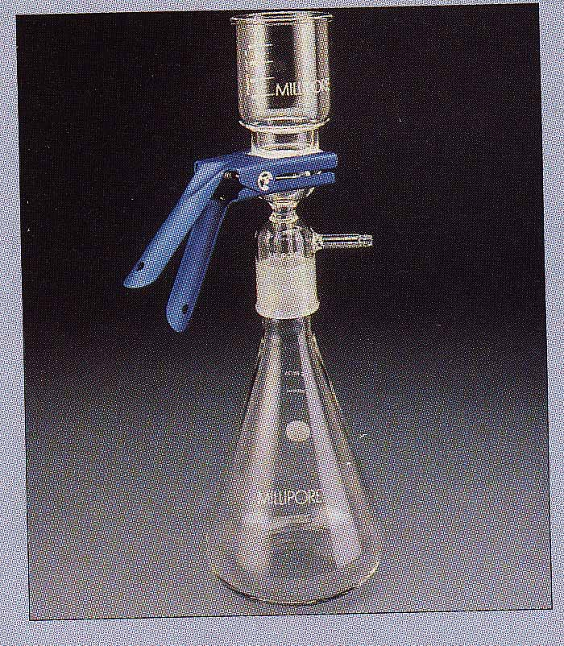

Physical Methods of Microbial Control
Heat
Filtration
Radiation

Slide 67
Physical Methods of Microbial Control
Heat
Kills microorganisms by denaturing their enzymes and other proteins. Heat resistance varies widely among microbes.
Fast, reliable, inexpensive
Does not introduce potential toxic substances
Types of heat control include
Moist heat
Pasteurization
Dry heat

Slide 68
Physical Methods of Microbial Control
Moist Heat: Kills microorganisms by coagulating their proteins.
Boiling:
Heat to 100ºC or more at sea level Kills vegetative forms of bacterial pathogens
Most pathogens can be killed within 10 minutes or less
Endospores and some viruses are not destroyed this quickly.
In general, moist heat is much more effective than dry heat.

Slide 69
Physical Methods of Microbial Control
Autoclave:
Chamber which is filled with hot steam under pressure.
Preferred method of sterilization, unless material is damaged by heat, moisture, or high pressure.
Temperature of steam reaches 121ºC at twice atmospheric pressure
All organisms and endospores are killed within 15 minutes.

Slide 70
Physical Methods of Microbial Control
Pasteurization:
Developed by Louis Pasteur to prevent the spoilage of beverages.
Used to reduce microbes responsible for spoilage of beer, milk, wine, juices, etc.
Classic Method of Pasteurization: Milk was exposed to 65ºC for 30 minutes.
High Temperature Short Time Pasteurization (HTST): Used today. Milk is exposed to 72ºC for 15 seconds.

Slide 71
Physical Methods of Microbial Control
Dry Heat:
Direct Flaming:
Used to sterilize inoculating loops and needles.
Heat metal until it has a red glow.
Incineration:
Effective way to sterilize disposable items (paper cups, dressings) and biological waste.
Hot Air Sterilization:
Place objects in an oven.
Require 2 hours at 170ºC for sterilization.
Dry heat is transfers heat less effectively to a cool body, than moist heat.

Slide 72
Physical Methods of Microbial Control
Filtration:
Removal of microbes by passage of a liquid or gas
through a screen like material with small pores.
Used to sterilize heat sensitive materials like
vaccines, enzymes, antibiotics, and some culture media.
Membrane Filters: Uniform pore size. Used in industry and research. Different sizes:
0.22 and 0.45um Pores: Used to filter most bacteria. Don’t retain spirochetes, mycoplasmas and viruses.
0.01 um Pores: Retain all viruses and some large proteins.
High Efficiency Particulate Air Filters (HEPA): Used in operating rooms to remove bacteria from air.

Slide 73
Physical Methods of Microbial Control
Low Temperature:
Effect depends on microbe and treatment applied.
Refrigeration:
Temperatures from 0 to 7ºC has Bacteriostatic effect.
Reduces metabolic rate of most microbes so they cannot reproduce or produce toxins.
Freezing: Temperatures below 0ºC.

Slide 74
Physical Methods of Microbial Control
Desiccation:
In the absence of water, microbes cannot grow or reproduce, but some may remain viable for years.
After water becomes available, they start growing again.
Susceptibility to desiccation varies widely:
Neisseria gonnorrhea: Only survives about one hour.
Mycobacterium tuberculosis: May survive several months.
Viruses are fairly resistant to desiccation.
Clostridium spp. and Bacillus spp.: May survive decades.

Slide 75
Physical Methods of Microbial Control
Osmotic Pressure:
The use of high concentrations of salts and sugars in foods is used to increase the osmotic pressure and create a hypertonic environment.
Plasmolysis:
As water leaves the cell, plasma membrane shrinks away from cell wall.
Yeasts and molds: More resistant to high osmotic pressures.
Staphylococci spp. that live on skin are fairly resistant to high osmotic pressure.

Slide 76
Physical Methods of Microbial Control
Radiation: Three types of radiation kill microbes:
Ionizing Radiation:
Gamma rays, X rays, electron beams, or higher energy rays.
Have short wavelengths (less than 1 nanometer).
Used to sterilize pharmaceuticals, disposable medical supplies and food.
Disadvantages:
Penetrates human tissues.
May cause genetic mutations in humans.

Slide 77
Ultraviolet light (Nonionizing Radiation):
Wavelength is longer than 1 nanometer.
Damages DNA by producing thymine dimers, which cause mutations.
Used to disinfect operating rooms, nurseries, cafeterias.
Disadvantages:
Damages skin, eyes.
Doesn’t penetrate paper,glass,and cloth.

Slide 78
3. Microwave Radiation:
Wavelength ranges from 1 millimeter to 1 meter.
Heat is absorbed by water molecules.
May kill vegetative cells in moist foods.
Bacterial endospores, which do not contain water, are not damaged by microwave radiation.
Solid foods are unevenly penetrated by microwaves.

Slide 79
Chemical Methods of Microbial Control Types of Disinfectants
1. Phenols and Phenolics:
Phenol (carbolic acid)
Was first used by Lister as a disinfectant.
Rarely used today because it is a skin irritant and has strong odor.
Phenolics are chemical derivatives of phenol
Cresols (Lysol): Derived from coal tar.
Biphenols:
Effective against gram-positive staphylococci and streptococci.
Excessive use in infants may cause neurological damage.
Destroy plasma membranes and denature proteins.
Advantages:
Stable, persist for long times after applied, and remain active in the presence of organic compounds.

Slide 80
Chemical Methods of Microbial Control Types of Disinfectants
2. Halogens: Effective alone or in compounds.
A. Iodine:
Iodine tincture (alcohol solution) was one of first antiseptics used.
B. Chlorine:
When mixed in water forms hypochlorous acid:
Cl₂ + H₂O ------> H+ + Cl- + HOCl
Hypochlorous acid
Used to disinfect drinking water, pools, and sewage.

Slide 81
Chemical Methods of Microbial Control Types of Disinfectants
3. Alcohols:
Kill bacteria, fungi, but not endospores or naked viruses.
Act by denaturing proteins and disrupting cell membranes.
Used to mechanically wipe microbes off skin before injections or blood drawing.
Not good for open wounds, because cause proteins to coagulate.
Ethanol: Drinking alcohol. Optimum concentration is 70%.
Isopropanol: Rubbing alcohol. Better disinfectant than ethanol. Also cheaper and less volatile.

Slide 82
Chemical Methods of Microbial Control Types of Disinfectants
4. Heavy Metals:
Include copper, selenium, mercury, silver, and zinc.
Very tiny amounts are effective.
A. Silver:
1% silver nitrate used to protect infants against gonorrheal eye infections, now has been replaced by erythromycin.
B. Mercury
Organic mercury compounds like merthiolate and mercurochrome are used to disinfect skin wounds.
C. Copper
Copper sulfate is used to kill algae in pools and fish tanks.

Slide 83
Chemical Methods of Microbial Control Types of Disinfectants
5. Aldehydes:
Include some of the most effective antimicrobials.
Inactivate proteins by forming covalent crosslinks with several functional groups.
A. Formaldehyde:
Excellent disinfectant, 2% aqueous solution.
Commonly used as formalin, a 37% aqueous solution.
Formalin was used extensively to preserve biological specimens and inactivate viruses and bacteria in vaccines.
Irritates mucous membranes, strong odor.
B. Glutaraldehyde:
Less irritating and more effective than formaldehyde.
Commonly used to disinfect hospital instruments.

Slide 84
6. Gaseous Sterilizers:
Chemicals that sterilize in a chamber similar to an autoclave.
Denature proteins, by replacing functional groups with alkyl groups.
Ethylene Oxide:
Kills all microbes and endospores, but requires exposure of 4 to 18 hours.

